Slide 1
Determinants of Life Expectancy Across Sub-Saharan African Countries
BUAN 6312
Shritej Shrikant Chavan, William Chase Guyton, Varun Golas,
Anusha Chennapragada, & Vedita K

Slide 2
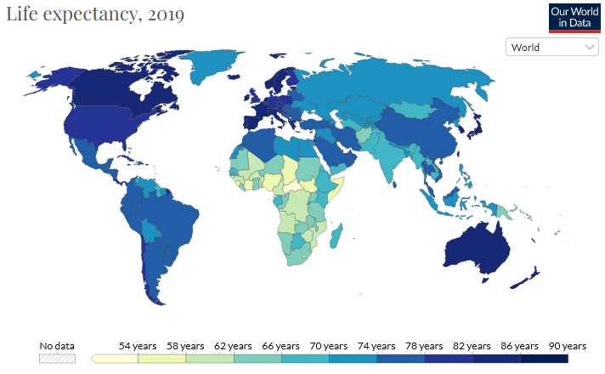
Introduction
Life expectancy is an important metric:
Quality of Life
Social Development
Intrinsically Positive
Life expectancy is rising slowly or stagnant in
developed countries
More room for more rapid
improvement in developing countries
Notes:
Explain Chart in detail.

Slide 3
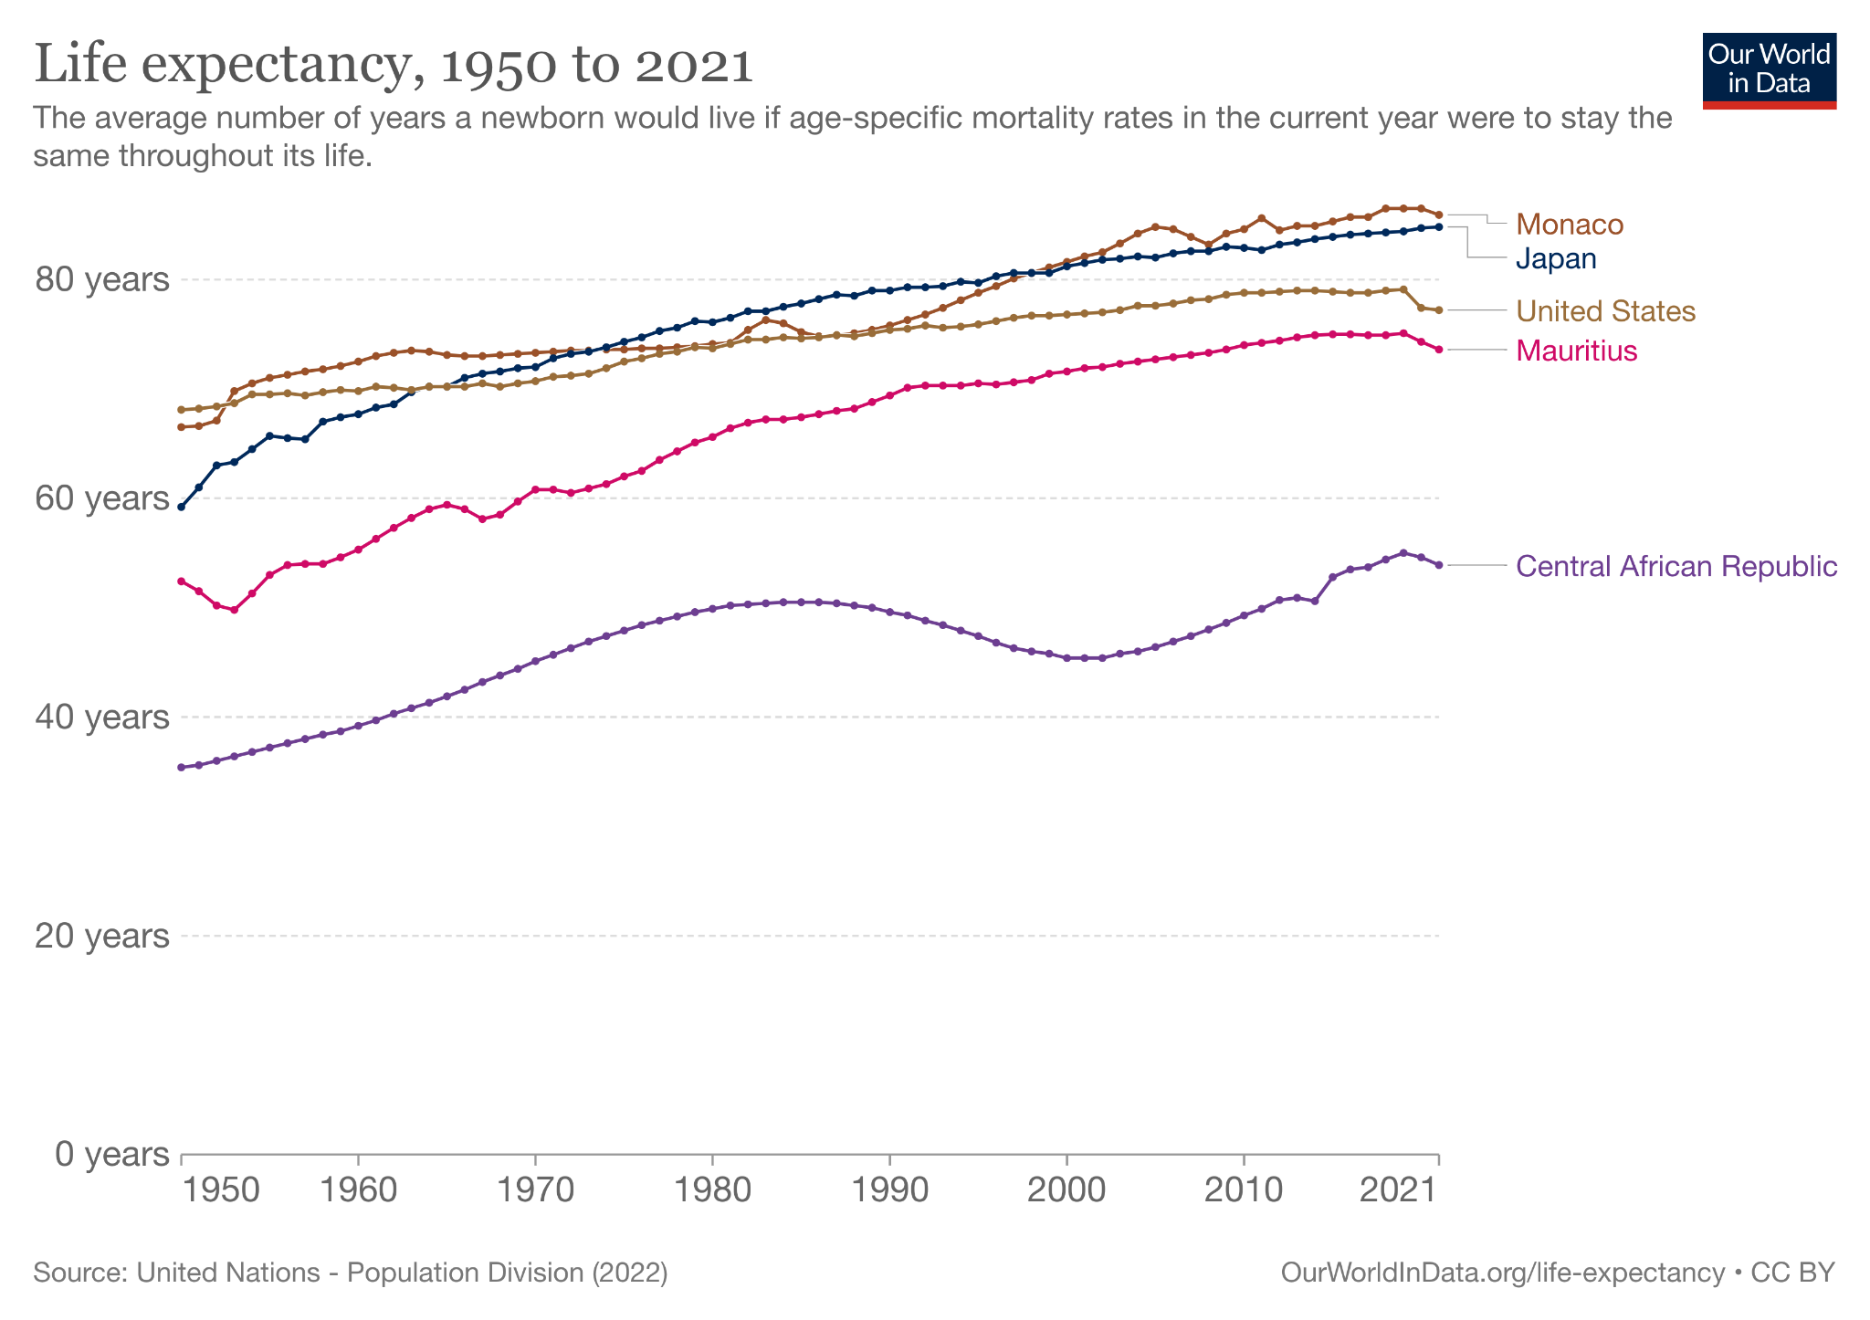
Life Expectancy
Country | L.E. (2020) (in years) | GDP per capita (2020)
Monaco | 86.50 | $159,221
Japan | 84.70 | $34,813
US | 77.40 | $58,203
Mauritius | 74.30 | $9,058
Central African Republic | 54.60 | $414
Source: United Nations - Population Division (2022)
Notes:
Always start in this order: Title, X & Y-axis. Monaco has highest life expectancy and Central African Republic has lowest. Explain the difference in GDP per capita
Speak about how African countries lagged behind and still are lagging. What measures in the past had been taken to improve life expectancy and how much are they effective?

Slide 4
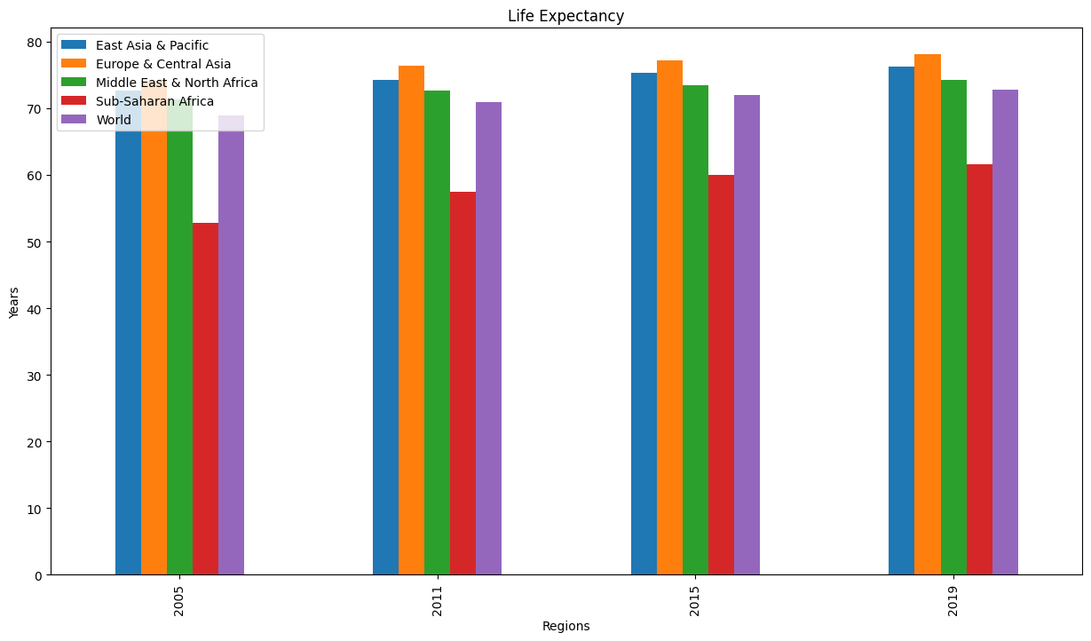
Regions
Region | L.E.(2019)
World | 72.8
Sub-Saharan Africa | 61.6
Middle East & North Africa | 74.3
Europe & Central Asia | 78.2
East Asia & Pacific | 76.2
Notes:
Highlight the drastic difference in Life Expectancy in these major regions throughout world
SSA region experiences lowest life expectancy at birth compared to other regions over the past three decades. In fact, the average life expectancy at birth for SSA countries was merely 58-year-old, compared to 73 and 75 for the Middle East and North Africa (MENA), and East Asia and the Pacific (EAP) regions respectively in year 2015

Slide 5
Research Questions
Aim : Better understanding of the major determinants of life expectancy in SSA region for efficient policy-making process, especially those that are related to achieve the United Nation’s Sustainable Development Goals (SDG) before year 2030
Questions Answered in our Research
What’s the Impact of Expenditure on Health and Education (% of GDP) on Life Expectancy?
How does prevalence of undernourishment and communicable disease affect Life Expectancy?
Do factors like corruption and unemployment rate impact life expectancy? If yes, quantify
Increase in CO2 emissions decrease life expectancy? Is it significant?
Notes:
Does spending on HealthCare and Education have a significant positive impact on Life Expectancy in African Countries?

Slide 6
Literature Review
Random-Effects model (2000-2015) on panel data proved that clean drinkable water; sanitation, and clean environment; and improved living standard were key to higher life expectancy at birth of citizens in 8 Sub-Saharan African (SSA) countries (Timothy, P. O. (2018).)
Least Squares Dummy Variables analysis show that economic (GDP per capita) and educational development of population in 38 African countries have positive effect on life expectancy whereas in some cases country features might have positive or negative effect (GUISAN, EXPOSITO, 2016)
Pooled OLS study of impact of foreign aid on life expectancy in SSA countries proved to be positive but insignificant Rizzo, T. (2019))

Slide 7
Data
Sub-Saharan African (SSA) countries - Low Life Expectancy & Low GDP per capita
Main Sources of data: The World Data Bank and Our World in Data
Out of 40+ SSA countries, due to lot of missing values for the indicators chosen, we focused on only 19
countries in that region
No record of CPIA data (corruption rating) for any country before 2005
Avoided data after 2019 due to prevalence of COVID
Indicators like Sanitation, Water Supply and Living standards weren’t available for many countries
Final panel data - N (countries) = 19 & T (years) = 15 (2005-2019)
[Benin, Burkina Faso, Central African Republic, Cameroon, Ethiopia, Ghana, Kenya, Lesotho, Madagascar, Mali, Mozambique, Mauritania, Malawi, Rwanda, Senegal, Sierra Leone, Chad, Togo, Tanzania]
Notes:
[Benin, Burkina Faso, Central African Republic, Cameroon, Ethiopia, Ghana, Kenya, Lesotho, Madagascar, Mali, Mozambique, Mauritania, Malawi, Rwanda, Senegal, Sierra Leone, Chad, Togo, Tanzania]

Slide 8
Indicators
Indicators | Units | Definitions
Prevalence of Undernourishment | % of population | % of undernourished population
Health Expenditure | % of GDP | Gov expenditure on Health (% of GDP)
Education Expenditure | % of GDP | Gov expenditure on Education (% of GDP)
Unemployment | % total labor force | % of unemployed but available labor force
Corruption | CPIA rating | Transparency, accountability, and corruption in the public sector
Disability-Adjusted Life Years (DALYs) due to Communicable diseases | DALY | One DALY equals one lost year of healthy life Per 100,000 individuals
Carbon dioxide emissions | Kiloton (kt) | Carbon dioxide emissions

Slide 9
Descriptive Statistics of Variables
VARIABLE | Unit | N (Countries) | T (Years) | Mean | Standard Deviation | Minimum | Maximum
Undernourishment | % | 19 | 15 | 20.75 | 11.38 | 3.1 | 49.9
CO2 | kiloton | 19 | 15 | 4724.74 | 4687.9 | 120 | 22280
Health | % | 19 | 15 | 5.45 | 2.55 | 2.39 | 20.41
Life-Expectancy | Years | 19 | 15 | 57.99 | 6 | 42.6 | 69.02
Educ | % | 19 | 15 | 4.04 | 1.76 | 1.11 | 12.33
Unemployment | % | 19 | 15 | 5.34 | 5.56 | 0.6 | 31.31
Corruption | CPIA rating | 19 | 15 | 2.96 | 0.47 | 2 | 4
Communicable | Years | 19 | 15 | 8163658.8 | 6727729.82 | 626351.4 | 40790843.

Slide 10
Panel Data
Country Name | Country Code | Year | Undrnrshmnt | Health | Y | Educ | Unemp | Corruptn | log(com) | log_CO2
Benin | BEN | 2005 | 12.0 | 2.93 | 57.355 | 2.65 | 0.825 | 3.5 | 6.63 | 3.462
Burkina Faso | BFA | 2005 | 17.5 | 3.95 | 53.310 | 3.941 | 4.000 | 3.5 | 7.00 | 3.02
Central African Republic | CAF | 2005 | 39.6 | 4.36 | 44.744 | 1.65 | 5.695 | 2.5 | 6.57 | 2.34
Cameroon | CMR | 2005 | 15.9 | 4.09 | 52.760 | 2.65 | 4.400 | 2.5 | 7.03 | 3.70
Ethiopia | ETH | 2005 | 37.1 | 4.10 | 56.223 | 7.42 | 2.500 | 2.5 | 7.61 | 3.732

Slide 11
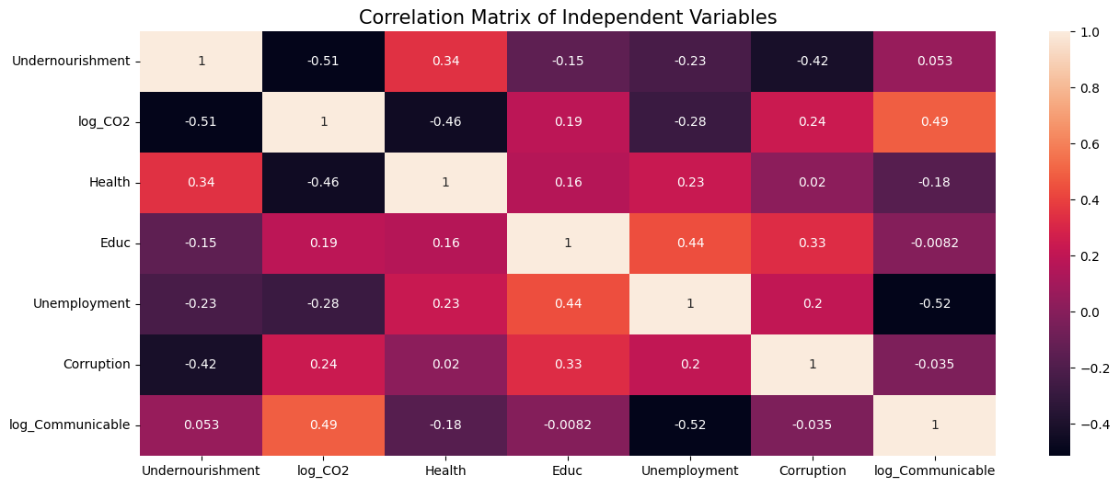
Checking Multicollinearity
Notes:
Maximum absolute correlation = 0.52. Mention which 2 variables and

Slide 12
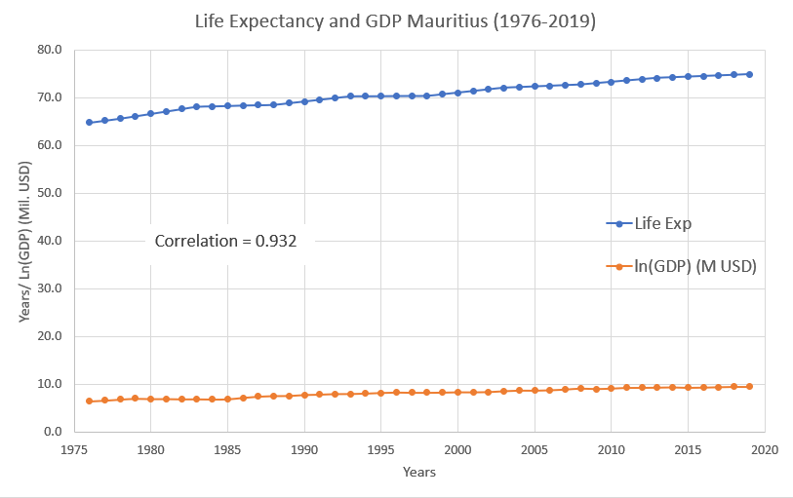
Empirical Method
Best Methodology:
Correlation between factors?
What’s the issue here?
Does this mean GDP positively impacts
Life Expectancy?
Correlation vs Causation !!!

Slide 13
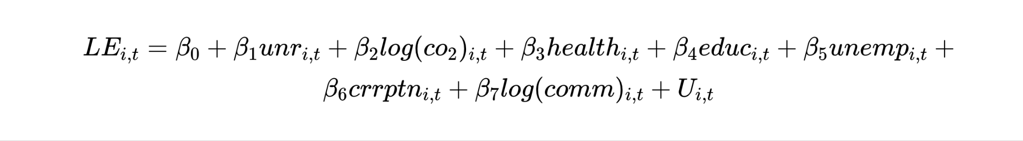
Panel Data Approach - Pooled OLS
unr - undernourished (% of population) co2 - CO2 emissions in kiloton health - Health expenditure (% of GDP)
unemp - unemployment (% of total labor force) crrptn - (CPIA) corruption in the public sector rating (1=low to 6=high)
Comm - Disability-adjusted life-years due to communicable diseases per 100,000 individuals
educ - Education expenditure (% of GDP)

Slide 14
Results - Pooled OLS
R-squared = 0.6638
 | Parameters | Std. Error | T-stat | P-Value | Lower CI | Upper CI
Intercept | 79.54 | 11.98 | 6.64 | 0.000 | 55.95 | 103.13
Undernour | 0.10 | 0.10 | 1.05 | 0.2940 | -0.091 | 0.30
log(CO2) | 9.94 | 1.34 | 7.44 | 0.000 | 7.31 | 12.57
Health | -0.024 | 0.39 | -0.063 | 0.950 | -0.79 | 0.74
Educ | 0.13 | 0.30 | 0.43 | 0.666 | -0.46 | 0.72
Unemploy | -0.46 | 0.14 | -3.20 | 0.002 | -0.75 | -0.178
Corruption | 2.01 | 1.75 | 1.15 | 0.252 | -1.43 | 5.45
Log(Comm) | -9.11 | 1.90 | -4.80 | 0.000 | -12.85 | -5.36

Slide 15
Assumption for Pooled OLS
TS.1 : Linear in Parameters - Linearity is ensured by taking functional forms of some variables
TS.2 : No perfect collinearity - Pearson’s Correlation Matrix reveals no perfect collinearity between the chosen indicators
TS.3 : Contemporaneous Exogeneity - Ensures that estimators are consistent
TS.4 : Homoscedasticity - Can be evaluated by various tests like White test, Breusch-Pagan test or just by plotting Residuals vs Fitted Values and observing its variance
TS.5 - No Serial Correlation among error term (residuals) - Durbin-Watson test, Ljung-Box test
Last 3 assumptions are hard to satisfy for Pooled OLS!!

Slide 16
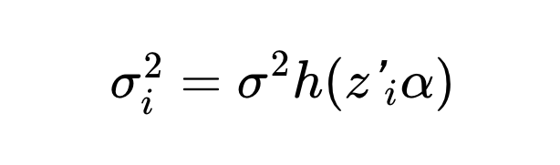
TS.4: Test for Heteroscedasticity
White-Test- (Ho : Homoscedasticity)
Regresses the squared residuals from the original regression model onto a set of regressors that contain the original regressors along with their squares and cross-products
LM = n*R-squared
Breusch-Pagan test - (Ho - Homoscedasticity) - better for large no. of independent variables
Checks for the linear form of heteroskedasticity i.e. it models the error variance as
Zi - vector of independent variables
Notes:
LM - follows a chi-squared distribution, with degrees of freedom equal to P − 1, where P is the number of estimated parameters (in the auxiliary regression).

Slide 17
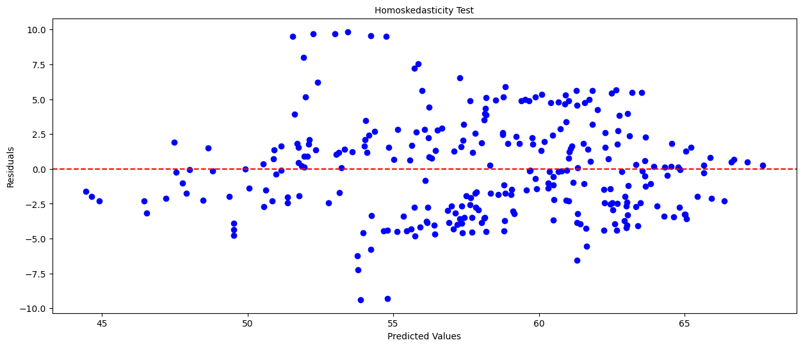
Results of Tests for Heteroscedasticity
Test | LM (p-val) | F p-val
White-Test | 1.46e-21 | 3.02e-37
Breusch-Pagan-Test | 1.62e-09 | 1.73e-10
Null - Rejected :
Heteroscedasticity exists !!!

Slide 18
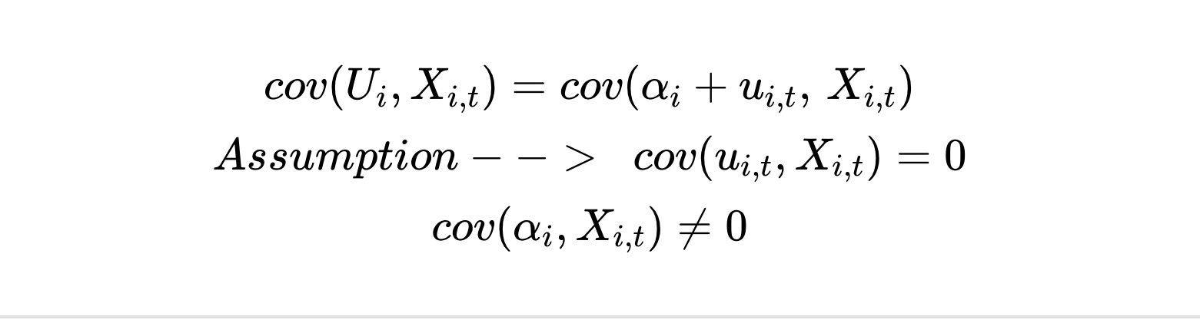
TS.3 : Contemporaneous Exogeneity
For Pooled OLS:
What’s the solution for above problem?

Slide 19
TS. 5: Tests for Serial Correlation
Durbin-Watson-Test: will have one output between 0 – 4.
mean (= 2) - no autocorrelation
0 – 2 = positive autocorrelation (the nearer to zero the higher the correlation)
2 – 4 = negative autocorrelation (the nearer to four the higher the correlation)
Results: Statistic = 1.64 ( a slight positive autocorrelation)
Ljung-Box Test: Checks for autocorrelation between all lags of error residuals
Results: p-val for all lags < 0.05 (No autocorrelation between residuals)

Slide 20
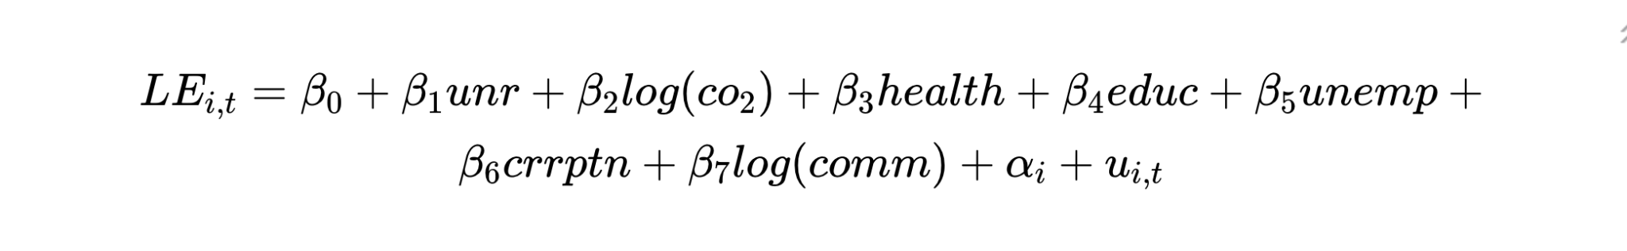
Individual Fixed Effects Model
Individual effects of independent variables are fixed over time
unr - undernourished (% of population); co2 - CO2 emissions in kiloton; health - Health expenditure (% of GDP)
unemp - uemployment (% of total labor force); educ - Education expenditure (% of GDP)
crrptn - (CPIA) corruption in the public sector rating (1=low to 6=high)
Comm - Disability-adjusted life-years due to communicable diseases per 100,000 individuals;

Slide 21
Results - Individual Fixed Effects
R-squared = 0.9040
 | Parameters | Std. Error | T-stat | P-Value | Lower CI | Upper CI
Intercept | 289.23 | 10.53 | 27.46 | 0.000 | 268.49 | 309.97
Undernour. | 0.0015 | 0.015 | 0.10 | 0.919 | -0.027 | 0.03
log(CO2) | 7.04 | 0.52 | 13.62 | 0.000 | 6.02 | 8.06
Health | 0.24 | 0.048 | 5.00 | 0.000 | 0.15 | 0.34
Educ. | 0.23 | 0.051 | 4.54 | 0.000 | 0.13 | 0.33
Unemploy. | -0.17 | 0.057 | -3.03 | 0.003 | -0.28 | -0.060
Corruption | -1.10 | 0.26 | -4.25 | 0.000 | -1.61 | -0.59
Log(Comm) | -37.48 | 1.38 | -27.12 | 0.000 | -40.20 | -34.76

Slide 22
Random Effects Model
Individual effects of independent variables vary over time
unr - undernourished (% of population); co2 - CO2 emissions in kiloton; health - Health expenditure (% of GDP)
unemp - uemployment (% of total labor force);
crrptn - (CPIA) corruption in the public sector rating (1=low to 6=high)
Comm - Disability-adjusted life-years due to communicable diseases per 100,000 individuals;
educ - Education expenditure (% of GDP)

Slide 23
Results - Random Effects
R-squared = 0.8486
 | Parameters | Std. Error | T-stat | P-Value | Lower CI | Upper CI
Intercept | 217.44 | 10.48 | 20.74 | 0.000 | 196.81 | 238.08
Undernour. | 0.0087 | 0.018 | 0.49 | 0.627 | -0.026 | 0.044
log(CO2) | 9.40 | 0 | 16.48 | 0.000 | 8.27 | 10.52
Health | 0.23 | 0.058 | 4.01 | 0.000 | 0.12 | 0.35
Educ. | 0.22 | 0.062 | 3.58 | 0.000 | 0.010 | 0.34
Unemploy. | -0.32 | 0.065 | -4.90 | 0.000 | -0.45 | -0.19
Corruption | -0.88 | 0.31 | -2.80 | 0.006 | -1.50 | -0.26
Log(Comm) | -28.05 | 1.37 | 20.45 | 0.000 | -30.75 | -25.35

Slide 24
Test of endogeneity
Hausman Test: The test evaluates the consistency of an estimator when compared to an alternative, less efficient estimator which is already known to be consistent
b0 - always consistent; b1 - only consistent under H0
Results:
Null Hypothesis is rejected, therefore Fixed Effects is preferred over Random Effects since the estimator is consistent
Chi-Squared | Degrees of freedom | p-value
729.805 | 8 | 2.7e-152

Slide 25
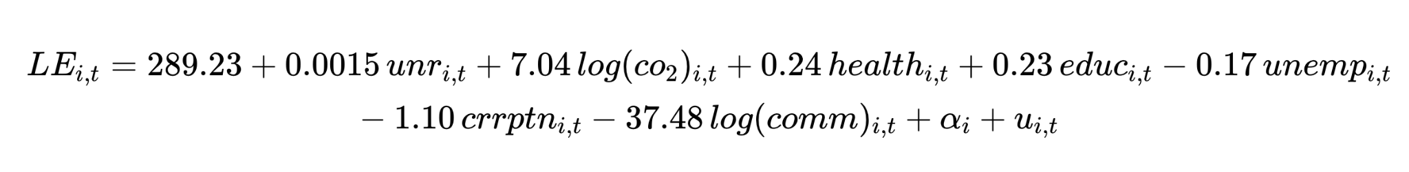
Final Econometrics Model for Life Expectancy (F.E.)
R-squared = 0.9040
From Fixed Effects results - Except for Prevalence of Undernourishment all variables are significant
(below results are concluded by keeping other factors constant)
1% Increase in CO2 emissions increases Life Expectancy by 0.07 years (not expected)
1% points increase in health and education expenditure (% of GDP) cause life expectancy to increase by 0.24 and 0.23 years respectively (expected)
1% point increase in unemployment (% of total labor force) decreases life expectancy by .17 years (e)
1 point increase in the CPIA rating decreases the life expectancy by 1.1 years (e)
1% increase in disability-adjusted life year per 100,000 individuals, decreases L.E. by 0.37 years (e)

Slide 26
Conclusions
Most of our independent variables showed expected significant behaviour.
An increase in health and education expenditure and a decrease in the unemployment rate and corruption should have positive ceteris paribus effect on life expectancy.
An increase in disability-adjusted life years specifically due to communicable diseases puts the population in danger and lowers the life expectancy of that respective country. The opposite effect was observed of disability-adjusted life years specifically due to non-communicable diseases & injuries.
CO2 output has a positive effect on life expectancy due to industrialization.
Our analysis shows what government can do to uplift the life-expectancy in these low-income countries and how can it direct the efforts in order to achieve this goal.

Slide 27
Limitations
Further, we can control for endogeneity by introducing Instrument Variables and performing 2SLS.
First, due to the lack of availability of time-series data on certain factors such as doctor-patient ratio, public vs private healthcare services, and efficiency we cannot control for these factors.
We are not analyzing causal impact of any policies that might have been in effect during the time period.
Certain factors might have data quality issues, since some countries have good reporting systems while others rely on estimation methods and data quality varies over countries.
Completing this study with details analysis of these determinants (probably at micro level analysis) will be important for the purposes of effective policy making.

Slide 28
Bibliography
Bergh, A., & Nilsson, T. (2010). Good for Living? On the relationship between Globalization and Life Expectancy. World Development, 38(9), 1191-1203.
Kabir, M. (2008). Determinants of Life Expectancy in Developing Countries. Journal of Developing Areas, 41(2), 185-204.
Linden, M., & Ray, D. (2017).). Aggregative bias-correcting Approach to the Health-Income relationship: Life-Expectancy and Gross Domestic Product per capita in 148 countries. Economic Modelling, 61, 126-136.
Rizzo, T. (2019). A PANEL DATA STUDY OF THE DETERMINANTS OF LIFE EXPECTANCY IN LOW INCOME COUNTRIES. Honors Thesis.
Roffia, P., & Bucciol, A. (2022). Determinants of life expectancy at birth: a longitudinal study on OECD countries. International Journal of Health Economics and Management, 1-24.
Roser, M., Ortiz, E., & Ritchie, H. (2013). Life Expectancy. Our World in Data. Retrieved November 24, 2022, from https://ourworldindata.org/life-expectancy
Timothy, P. O. (2018). Macroeconomic Implications of Low Life Expectancy in Sub-Saharan Africa Nations: A Panel Technique Approach. Social Sciences, 7(1), 7-12. 10.11648/j.ss.20180701.12. https://www.sciencepublishinggroup.com/journal/index?journalid=202

Slide 29

Questions?

